Slide 1
Solar, STELLAR and lunar photometry Lionel Doppler @IPC+FRC - Davos 20210929

Slide 2
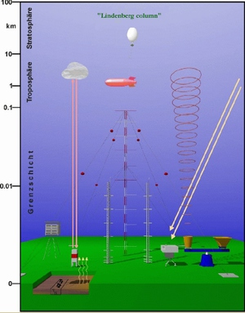
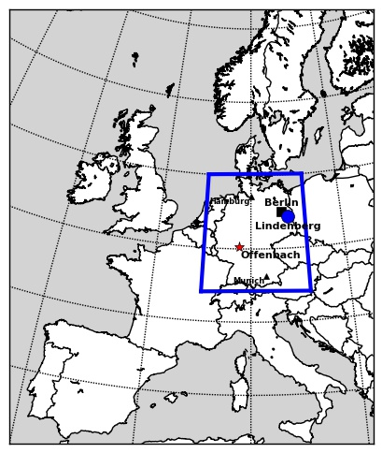
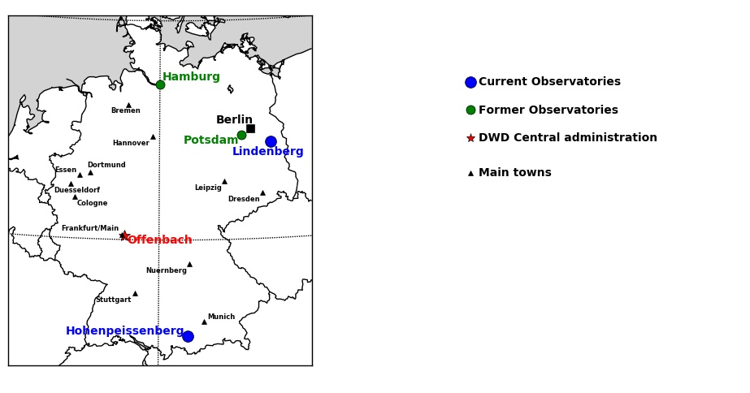
DWD/MOL-RAO
MOL-RAO
Observatory Lindenberg
MOL1
Remote Sensing
MOL2
Boundary Layer
MOL3
In-Situ Sounding
MOL4
Radiation
Processes
Lionel Doppler
Solar, STELLAR and lunar photometry
IPC/FRC – Davos - 20210929

Slide 3
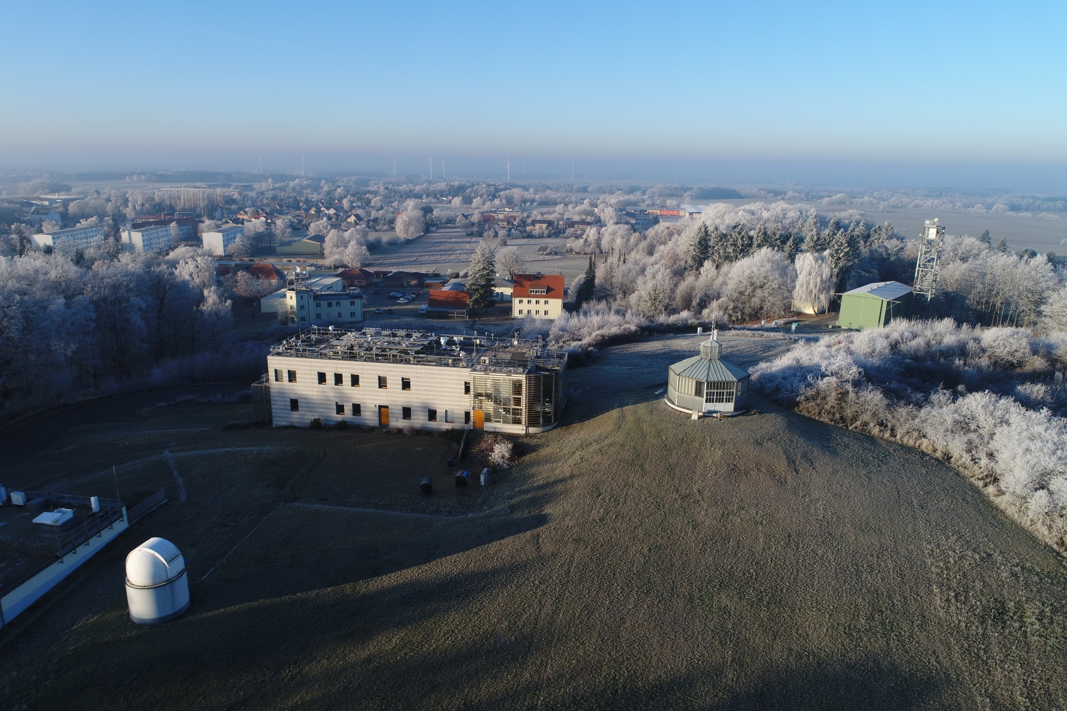
MOL-RAO: 52.2 N, 14.1 E, 120 m
GM Falkenberg (e.g. 99 m tower)
50 m tower
„Wetterwarte“
Weather station
Radiation platform
Balloon hall
“Strahlungsmesszentrale”
(radiation lab)
Wind house (historic)
Starphotometer
Remote sensing station
(Cloud radar, Doppler Lidar, Windprofiler)
RAMSES
(Raman Lidar)
Lionel Doppler
Solar, STELLAR and lunar photometry
IPC/FRC – Davos - 20210929

Slide 4
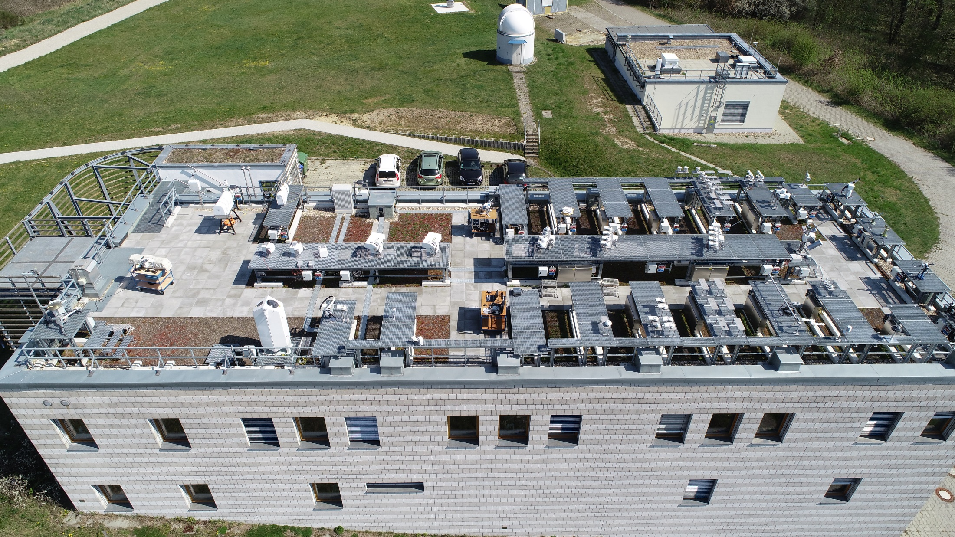
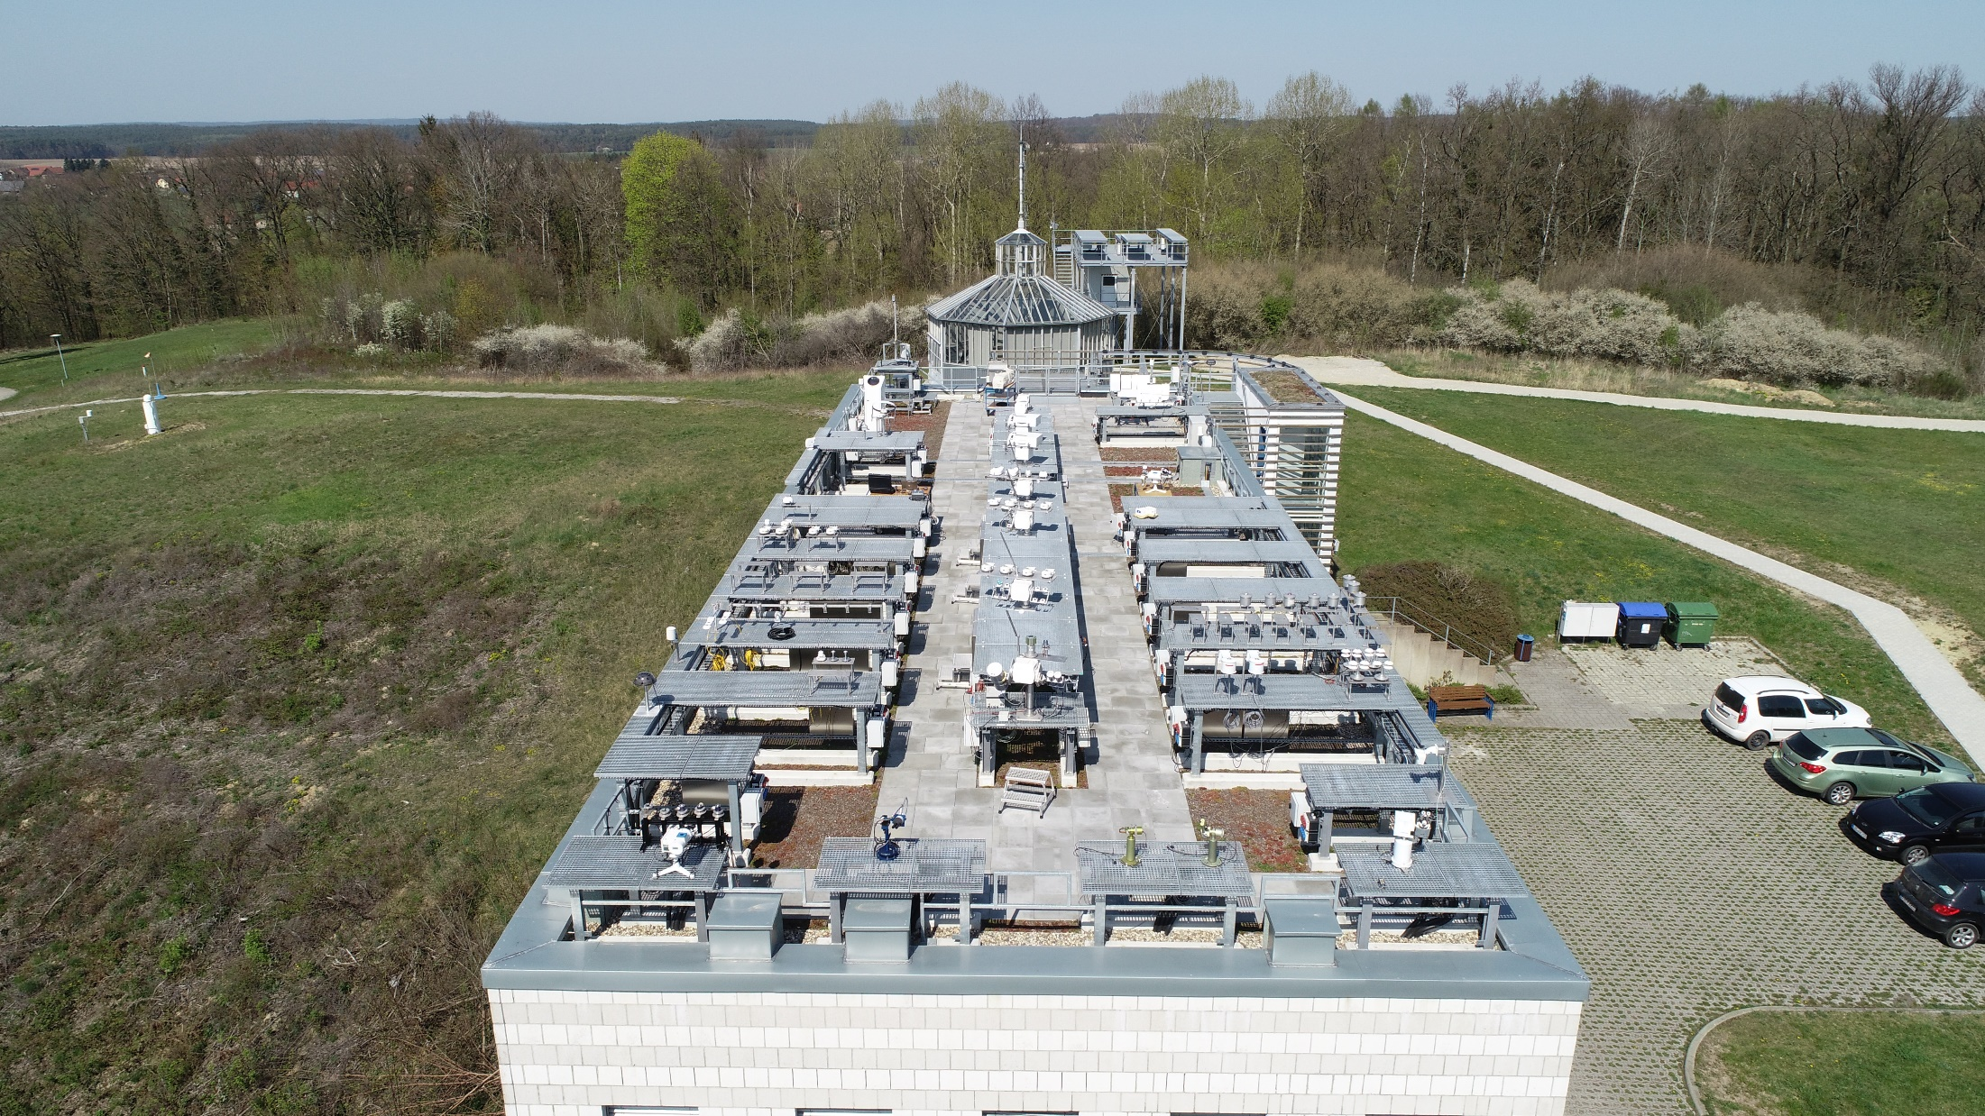
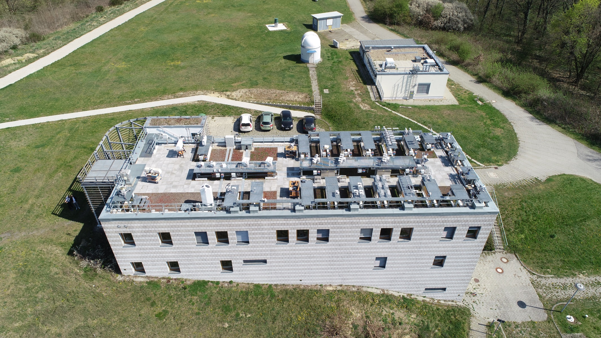
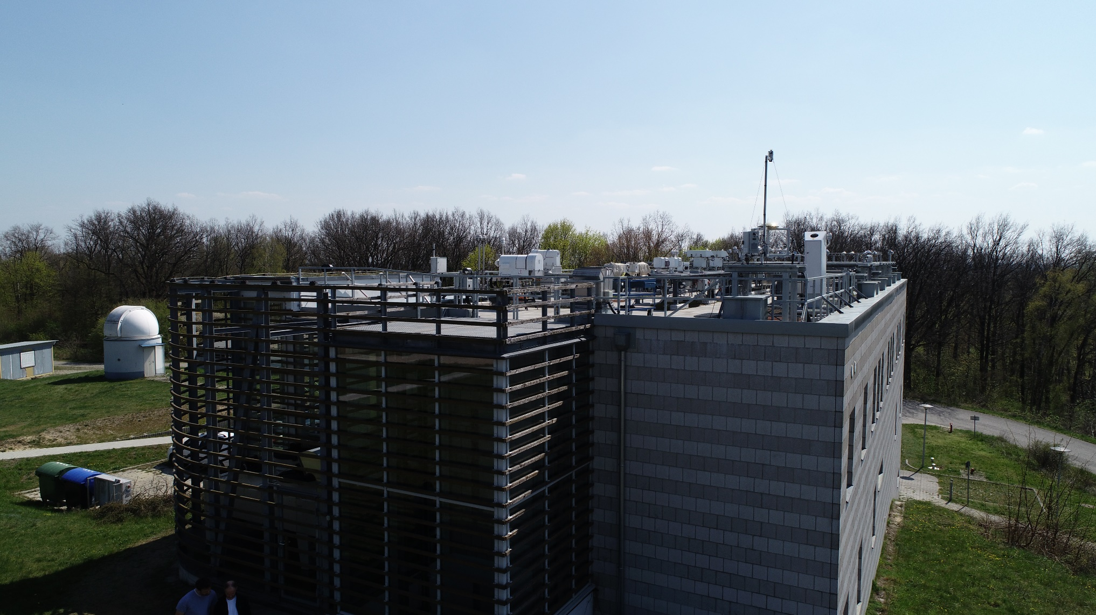
Radiation platform
Lionel Doppler
Solar, STELLAR and lunar photometry
IPC/FRC – Davos - 20210929

Slide 5
Basis of AOD photometry
Sun: „V0“, Langley-plot
Moon: „RIMO (ROLO)“, Moon Langley-plot + NASA
Star: „SEMI“: Star-catalog + 2 Star-Method
I_{0,λ}
Atmosphere’s entrance
AOD ???
Aerosol layer
AOD = Aerosol Optical Depth
I_{λ}
Instrument:
Filterradiometer (ex: λ = 500 nm)
Beer-Lambert law at wavelength „λ“:
Measured
Known
(measurement + spectral computation)
Known (V0, RIMO, SEMI)
Lionel Doppler
Solar, STELLAR and lunar photometry
IPC/FRC – Davos - 20210929

Slide 6
Stellar Photometry/Radiometry/Spectrometry
Lionel Doppler
Solar, STELLAR and lunar photometry
IPC/FRC – Davos - 20210929

Slide 7
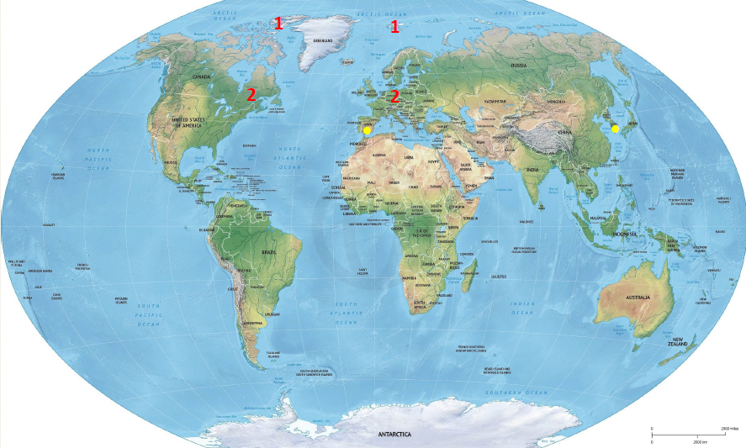
Starphotometers in the world
Only 8!
© Liviu Ivanescu, presentation SCILLA, Lindenberg, September 2020
Lionel Doppler
Solar, STELLAR and lunar photometry
IPC/FRC – Davos - 20210929

Slide 8
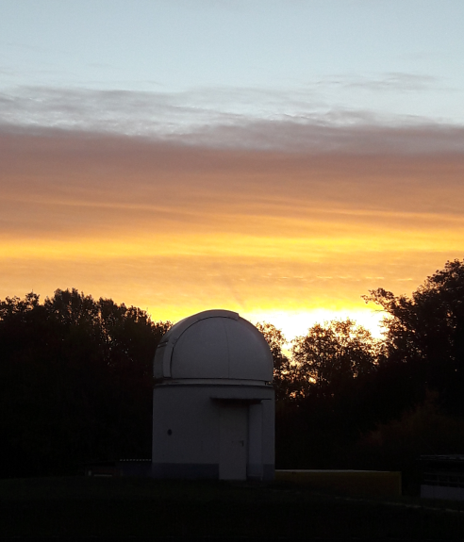
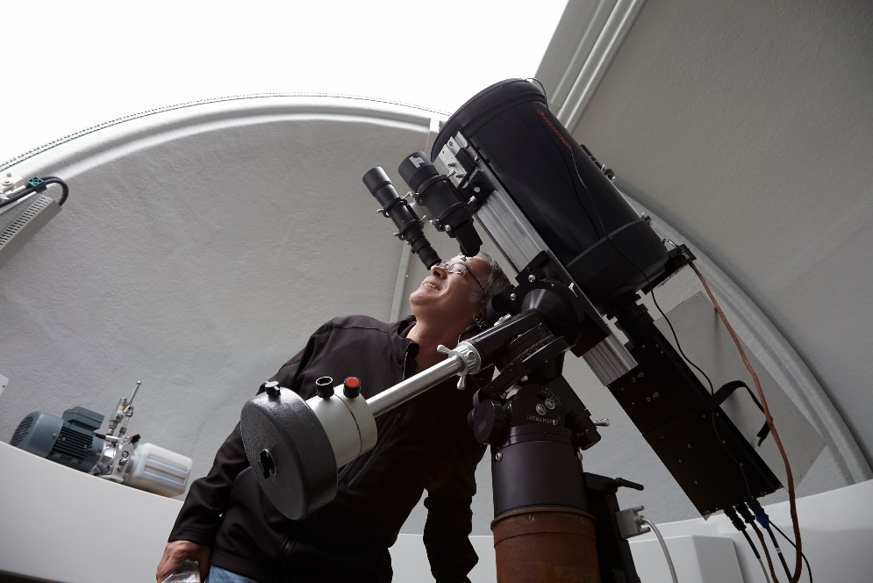
Why only 8?
A dome
A telescope
An operator
Lionel Doppler
Solar, STELLAR and lunar photometry
IPC/FRC – Davos - 20210929

Slide 9
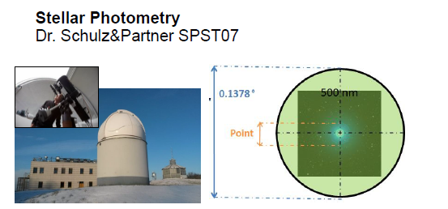
Why a telescope?
Need to focus on stars = points less than 0.01°
Lionel Doppler
Solar, STELLAR and lunar photometry
IPC/FRC – Davos - 20210929

Slide 10
Principles of the stellar photometry
I_{0_inst}
Atmosphere’s entrance
AOD ???
Aerosol layer
Beer-Lambert equation !
I_{λ}
Instrument:
Filter radiometer (ex: λ = 500 nm)
$$Iλ\left(measure\right)=E0λ×e^{−τ/\cos{SZA}}$$
$$τ=τgas+τaerosol+τclouds=ln⁡(\frac{I0_inst}{Iλ}) ×\cos{SZA}$$
$AOD=τaerosol=ln⁡(\frac{I0_inst}{Iλ}) ×\cos{SZA}$ - $τgas−τclouds$
$τgas=τRay+τO3abs+τSO2abs+$ $τNO2abs$+ $τH2Oabs$+ $τO2abs$
Lionel Doppler
Solar, STELLAR and lunar photometry
IPC/FRC – Davos - 20210929

Slide 11
What we need
I_{0_inst}
Atmosphere’s entrance
AOD ???
Aerosol layer
I_{λ}
Instrument:
Filter radiometer (ex: λ = 500 nm)
A measurement of $Iλ$ (Filter radiometer or spectrometer)
A knowledge of I_{0_inst} (or “V₀”) thanks to the calibration
V₀ depends on: The star and the instrument: Name is SEMI for stellar phot.
SEMI = Star Extra-terrestrial Magnitude Instrumental
Lionel Doppler
Solar, STELLAR and lunar photometry
IPC/FRC – Davos - 20210929

Slide 12
How to get I_{0_inst} (V₀)
FIRST OPTION: Langley-Plot
That requires:
Stable atmosphere: stable turbidity ($τaerosol$ and $τgas$)
Elevated and dry site
Or: Transportable system
Solution for ESCALIBURE (EXtinction CAmera and LumInance
BackgroUnd Register) = starphotometer of Granada
Lionel Doppler
Solar, STELLAR and lunar photometry
IPC/FRC – Davos - 20210929

Slide 13
How to get SEMI I_{0_inst} (V₀)
Beer-Lambert
TSM
Upper Star
OSM
OTHER OPTION:
Two stars method (TSM)
Used in Lindenberg, Eureka, Sherbrooke, Ny-Alesund
(SPST = not transportable system):
U₀₁
Only Star
m₁
U_{0S}
Lower Star
m₁
U₀₂
m₂
U₁
U_{S}
U₂
STP
→We need U₀₁ – U₀₂ SEMI1 – SEMI2 (Stars Extraterrestrial Magnitude Instrumental: I_{0_inst} for astronomy) from upper star to lower star.
→ But U₀₁ ~ ln(I_{0inst1}) = ln(f◦I₀₁) → U₀₁ – U₀₂ = ln(f◦I₀₁/f◦I₀₂) = ln(I₀₁/I₀₂) = M1-M2:
We only need Stars Extraterrestrial Magnitude (SEM or I₀) -> Catalog
U₀₁, U₀₂, U_{0S}: stars‘ magnitude // U₁, U₂, U_{S}: Measured magnitude // m₁, m₂, m_{S}: airmasses
Lionel Doppler
Solar, STELLAR and lunar photometry
IPC/FRC – Davos - 20210929

Slide 14
How to get I_{0_inst} (V₀)
TSM
Upper Star
OSM
U₀₁
Only Star
U_{0S}
m₁
Lower Star
m₁
U₀₂
m₂
U₁
U_{S}
U₂
STP
→ With SEM Catalog and TSM (U1 and U2 meas.) we can make monitoring of optical depth and AOD and get rid of instrumental function (no need SEMI)
→ With optical depth and U1 and U2 measurements we get SEMI1 and SEMI2, we store these values. Later OSM = one star photometry with Star 1 and Star 2
U₀₁, U₀₂, U_{0S}: stars‘ magnitude // U₁, U₂, U_{S}: Measured magnitude // m₁, m₂, m_{S}: airmasses
Lionel Doppler
Solar, STELLAR and lunar photometry
IPC/FRC – Davos - 20210929

Slide 15
Two stars measurements: summary
TSM
Upper Star
OSM
U₀₁
Only Star
U_{0S}
m₁
Lower Star
m₁
U₀₂
m₂
U₁
U_{S}
U₂
STP
→ TSM for having OD (then AOD) without “inst” part (without SEMI) of star magnitude but with the star magnitude independent of the instrument (SEMI)
→ TSM for calibration: compute SEMI1 and SEMI2 from TSM measurements for future OSM (one star method) photometry with star 1 and star 2
U₀₁, U₀₂, U_{0S}: stars‘ magnitude // U₁, U₂, U_{S}: Measured magnitude // m₁, m₂, m_{S}: airmasses
Lionel Doppler
Solar, STELLAR and lunar photometry
IPC/FRC – Davos - 20210929

Slide 16
Limits of TSM method
TSM
Upper Star
OSM
U₀₁
Only Star
U_{0S}
m₁
Lower Star
m₁
U₀₂
m₂
U₁
U_{S}
U₂
→ + We do not need a so stable atmosphere as for Langley-Plot
→ But we need homogeneous sky: OD same for lower and upper star
→ We need valuable SEM → good catalogue. Pulkovo Observatory catalog (Saint Petersburg) is our reference. But pretty old (stars change, resolution and precision standards of older time)
STP
U₀₁, U₀₂, U_{0S}: stars‘ magnitude // U₁, U₂, U_{S}: Measured magnitude // m₁, m₂, m_{S}: airmasses
Lionel Doppler
Solar, STELLAR and lunar photometry
IPC/FRC – Davos - 20210929

Slide 17
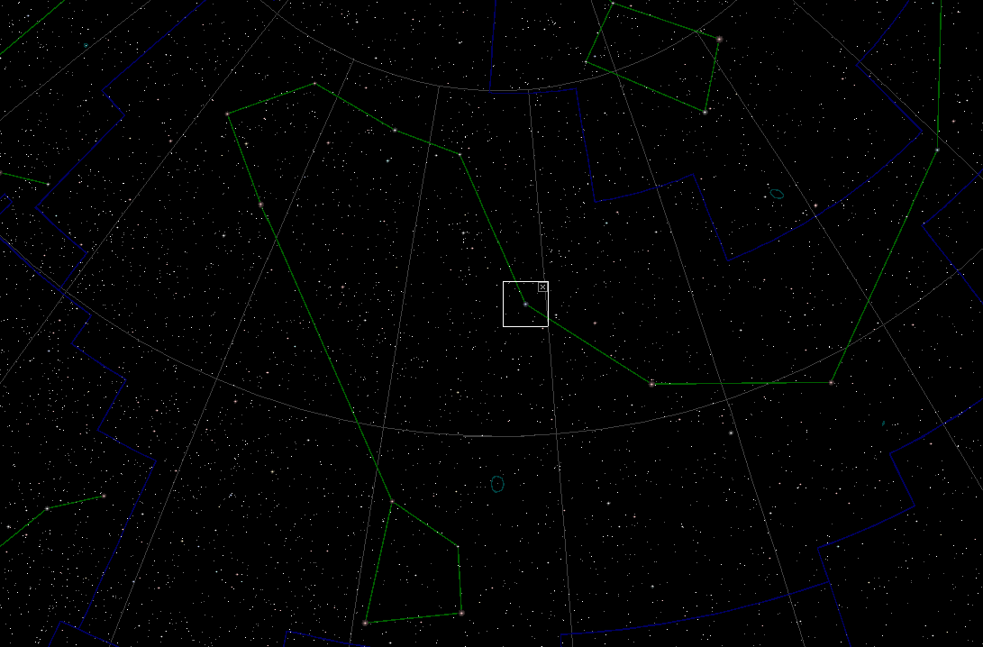
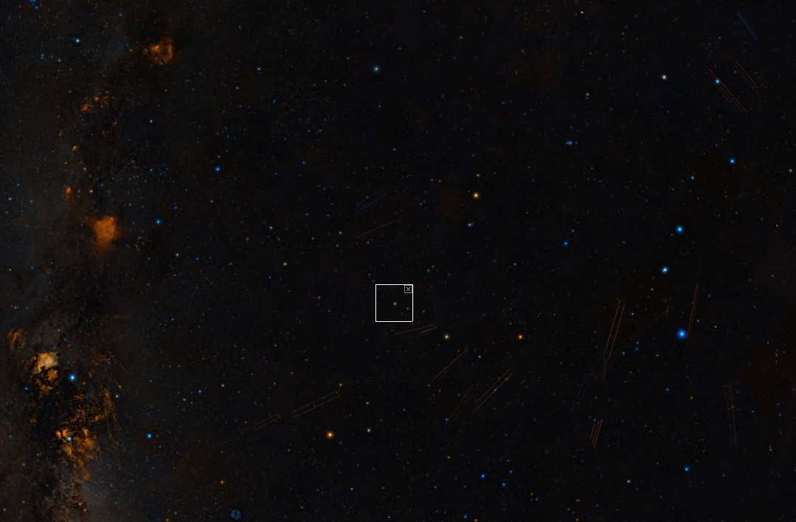
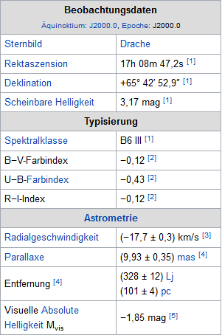
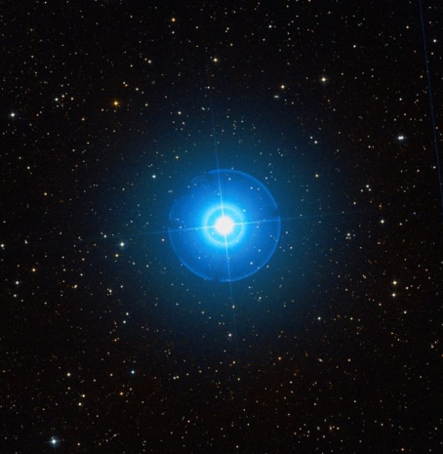
Stellar photometry targets
Zeta Draconis (ζ Dra) HR 6396 – Aldhibah
Beta Ursae Majoris (β UMa) HR 4295 – Merak
Eta Ursae Majoris (η UMa) HR 5191 - Alkaid
Beta Tauri (β Tauri) HR 1791 - Elnath
Kappa Orionis (κ Ori) HR 2004 - Saiph
Lionel Doppler
Solar, STELLAR and lunar photometry
IPC/FRC – Davos - 20210929

Slide 18
Stellar photometry: summary
Only 8 active stations in the world
Because infrastructure, maintenance and personal costs (dome, telescope, operator)
Calibration: Langley Plot or TSM (two star method)
Two options: Langley Plot + filter radiometer (ESCALIBURE, Granada)
or TSM and spectrometer (Dr. Schulz & Partner SPST: Canada, Ny-Å, Lindenberg)
Langley Plot = need portable, exclude low stars, need a lot of calibration (many stars)
TSM original, efficient, but dependency in SEM (Star magnitude) catalogue
TSM for AOD monitoring or TSM for calibration (SEMI) for 1 star method normal photometry with star 1 and star 2
TSM or Langley-Plot gives a set of +/- 8 stars for which we have SEMI an make then normal AOD photometry
Lionel Doppler
Solar, STELLAR and lunar photometry
IPC/FRC – Davos - 20210929

Slide 19
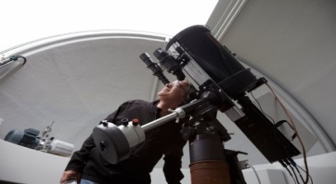
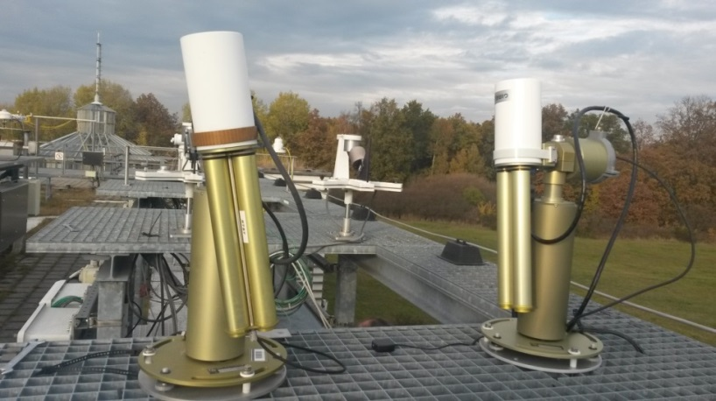
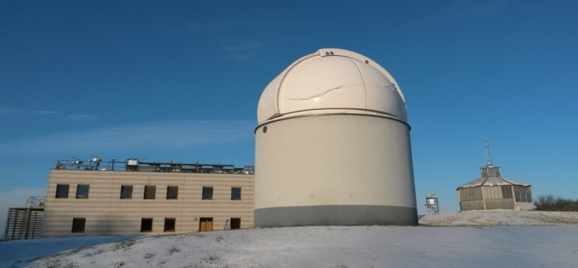
Specificity and +/- of Lunar / Solar / Stellar
Sun-photo-metry
Since 1980ies (1986)
Since 2010ies (2015)
Star-/Lunarphotometry
Since 1990ies (1992)
Lionel Doppler
Solar, STELLAR and lunar photometry
IPC/FRC – Davos - 20210929

Slide 20
Lunar or stellar?
Lionel Doppler
Solar, STELLAR and lunar photometry
IPC/FRC – Davos - 20210929

Slide 21
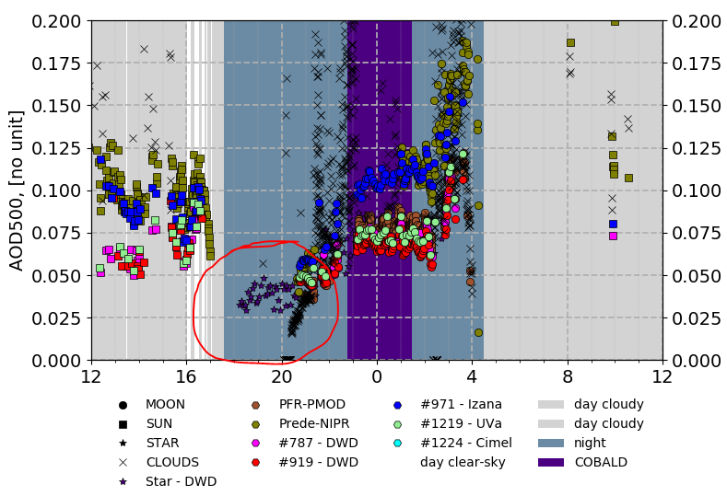
Lunar or stellar?
SCILLA. Summer Campaign Solar+Lunar+Stellar, Lindenberg 2020
Lionel Doppler
Solar, STELLAR and lunar photometry
IPC/FRC – Davos - 20210929

Slide 22
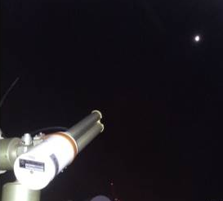
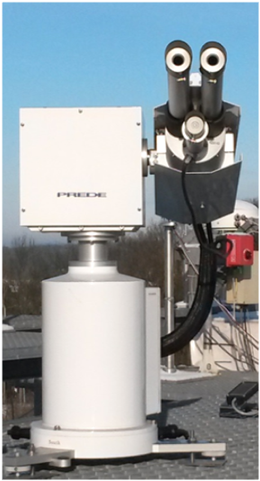
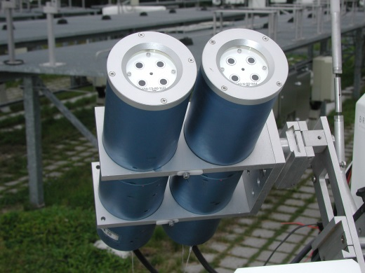
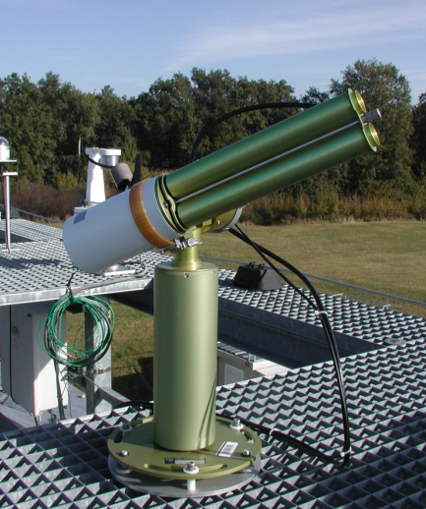
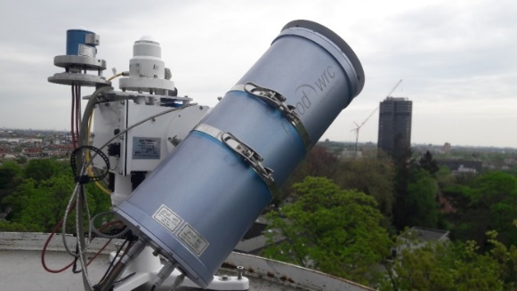
Photometry Instruments at MOL-RAO
PFR PMOD-WRC Sun GAW AOD (8)
CE318T Cimel Sun+Moon Aeronet AOD (6 o. 8), PWV
POM Prede Sun ESR(SkyRad) AOD (11)
SPST7 Schulz&Partner Star Ø AOD (17), PWV
PSR PMOD-WRC Sun + Glob Ø [315– 1020 nm]/1024
Lionel Doppler
Solar, STELLAR and lunar photometry
IPC/FRC – Davos - 20210929

Slide 23
Specificity Lunar/stellar/solar: summary
Solar = oldest and most certified and efficient technique
Since the 80ies
Portable and compact instrument
Great signal/noise ratio
Enough signal for UV, NIR, Ozone, (other techniques only VIS, AOD and WV)
Possibility scattering measurements and extract aerosol properties (SSA, Phase function)
Lunar:
Use same instrument as solar = compact, easy calibration
Difficulty of reflectance model, but this is almost mastered
Only Half of the cycle, only 2/3 of the night
Stellar:
Expansive, take place, calibration difficult, need (partially) an operator
Problem of star magnitude catalogue
But we can choose the target and measure almost the whole night, heterogeneity is possible
Lionel Doppler
Solar, STELLAR and lunar photometry
IPC/FRC – Davos - 20210929

Slide 24
THANKS for your attention

